Slide 1

Winning the Oscars: The Role of Prescriptive Analytics & Operations Research
A Case Study of Everything Everywhere All at Once
How Data Turned an Underdog into a Champion
By Vijay Rangaswamy

Slide 2
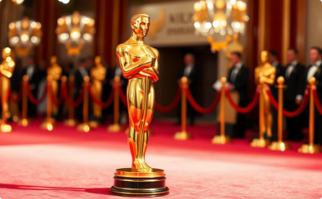
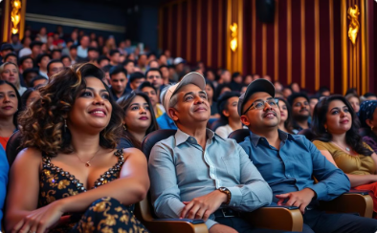


Introduction to the Oscars and Best Picture
Overview of the Oscars
Voting Body
Voting System
Significance
AMPAS has about 9,921 voters from 17 branches. Since 2016, membership has become more diverse, including more women, people of color, and international filmmakers.
Best Picture uses a preferential ballot system. Voters rank up to 10 films. Ballots are tallied by eliminating films with few #1 votes and reassigning them until one film has a majority.
Winning Best Picture needs strategic campaigning to appeal to a large, diverse voting body, favoring films with wide support.
The Academy Awards, started in 1929, are the film industry's top honors. The Best Picture award celebrates excellence in storytelling, direction, acting, and production.

Slide 3

Why Best Picture Matters
1
Prestige and Legacy
A Best Picture win immortalizes films in cinematic history, becoming cultural touchstones studied in film schools.
2
Financial Impact
A win boosts box office revenue significantly. Smaller films see even greater proportional gains in revenue.
Streaming and DVD sales also spike.
3
Career Advancement
Filmmakers gain industry leverage, leading to more opportunities. Actors often secure bigger roles after winning.
Studios secure funding for future projects more easily.
4
Studio Benefits
Studios enhance their reputation, rivaling larger studios. A win validates risky investments, encouraging innovative projects.

Slide 4



What is Prescriptive Analytics?
Definition: Prescriptive analytics recommends actions to achieve desired results, integrating data and optimization algorithms.
Process: Gathers diverse data (e.g., past Oscar winners), analyzes using machine learning to find patterns,
and recommends strategies (e.g., target voters).
Recommendations
1
Actionable strategies
Analysis
2
Machine learning models
3
Data Collection
Diverse inputs
Contrast with Other Analytics
Descriptive: "What happened?" (e.g., EEAAO won 7 Oscars).
Oscar Example
Predictive: "What might happen?" (e.g., EEAAO has a 20% chance based on buzz).
DGA award winners have an 80% chance of winning Best Picture (e.g., Nomadland). Prescriptive analytics advises prioritizing DGA outreach.
Prescriptive: "What should we do?" (e.g., Focus on guild awards).

Slide 5


What is Operations Research (OR)?
Definition: Operations Research (OR) uses math modeling to solve complex decisions.
Optimization
Decision Analysis
Best use of resources. Allocate budget to maximize voter reach (e.g., screenings, ads).
Weigh risks and benefits, like early vs. late release.
Oscar Application
Real-World Precedent
A24 could prioritize high-ROI activities—e.g., guild screenings over TV ads. Spend on DGA, SAG, and trade ads for impact.
Political campaigns use OR to target voters; Oscar campaigns mirror this by targeting Academy branches.

Slide 6




The Role of Data in Oscar Campaigns
Historical Trends
Guild Awards
Oscar data reveals patterns: dramas often win, but comedies and sci-fi can succeed (e.g., Annie Hall).
DGA, PGA, and SAG wins are strong predictors, aligning with Best Picture 75% of the time since 2000.
Voter Demographics
Film Metrics
Actors (25% of voters) favor performance-driven films; younger, diverse members boost unconventional picks.
Box office success ($100M+), critical acclaim (80+ Metacritic), and festival buzz (e.g., Sundance, TIFF) indicate voter appeal.
Value of Data
Case Example
Identifies success factors: 80% of Best Picture winners since 2000 won a major guild award.
Argo (2012) focused on PGA/SAG, winning Best Picture without a Best Director nod.
Enables targeting: Sway the Actors Branch (largest bloc) with ensemble casts.
Insight: Data transforms Oscar campaigns into a science, leveling the field for films like EEAAO.
Reduces guesswork: Prioritize resources based on evidence, not intuition.

Slide 7

EEAAO - The Starting Point (Summer 2022)
Film Overview
Released March 25, 2022, EEAAO is a $14.3M indie sci-fi comedy by the Daniels, produced by A24.
Initial Challenges
Budget: $3-5M campaign budget vs. competitors' $10-20M.
Genre Bias: Sci-fi comedies rarely win Best Picture.
Data Analysis
Competition: Heavyweights like Top Gun: Maverick.
A24 analyzed historical data: Indie films with guild wins often defied odds.
Predictive models gave EEAAO 15-20% Best Picture odds in June 2022, citing its $100M box office.
Prescriptive Insight
Recommendation: Focus on guild awards to build credibility among Academy voters.
Strategy: Host targeted screenings and Q&As.
OR Application
Budget optimization: Allocated 50% ($1.5-2.5M) to guild events, 30% to trade ads, 20% to social media.

Slide 8

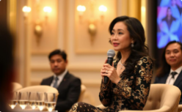


Building Momentum - Guild Campaigns (Fall 2022)
A24 strategically amplified buzz for EEAAO through targeted guild campaigns. Key events and budget allocations fueled growing industry recognition
and set the stage for awards season.
Guild Screenings
Intimate Q&As
Social Media Amplification
Early Recognition
50+ screenings highlighted innovative direction and cast versatility.
Yeoh, Quan, and Hsu targeted Actors/Directors Branches, emphasizing emotional stories.
Viral clips and memes engaged younger Academy voters.
Award nominations and guild shortlists indicated industry traction.
50+
$1M
Guild Screenings
Screening Budget
Nationwide events targeting key voting groups
Strategic allocation for maximum impact
$750K
$500K
Trade Ads
Social Media
Variety/THR campaign investment
Twitter/Instagram campaign spend
OR in Action: Optimized budget across channels; simulations predicted a SAG Ensemble nomination would boost odds by 10-15%.
Outcome: Buzz grew; Metacritic held at 81/100, setting the stage for 2023 wins.

Slide 9
Turning Point - Guild Wins (January-February 2023)
January 8, 2023
February 26, 2023
Golden Globes wins for Quan and Yeoh generated mainstream buzz.
SAG Ensemble win solidified actor support (25% of Academy voters).
February 18, 2023
DGA Award for the Daniels, a key Best Picture predictor.
Prescriptive Adjustment
OR Application
Analytics urged PGA outreach post-Globes, as PGA aligns with Best Picture 85% of the time.
Reallocated budget: $1M to Academy events, $500K to final ads.
Post-DGA simulations: Odds jumped to 75% with potential guild trifecta.
Focused late-season Academy screenings on undecided voters using guild momentum.
Outcome: By late February, EEAAO became the frontrunner, overtaking The Fabelmans and Top Gun: Maverick in betting odds, nearing the Oscar.

Slide 10

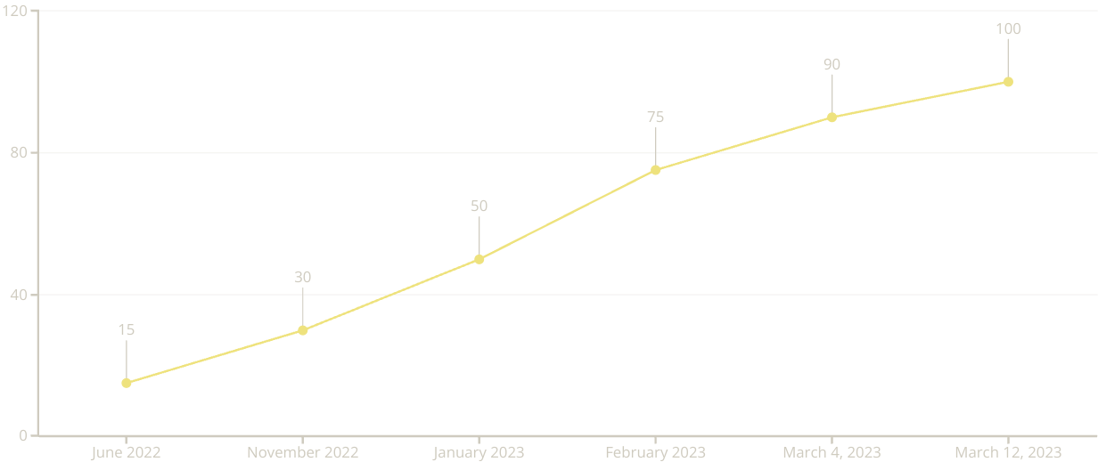
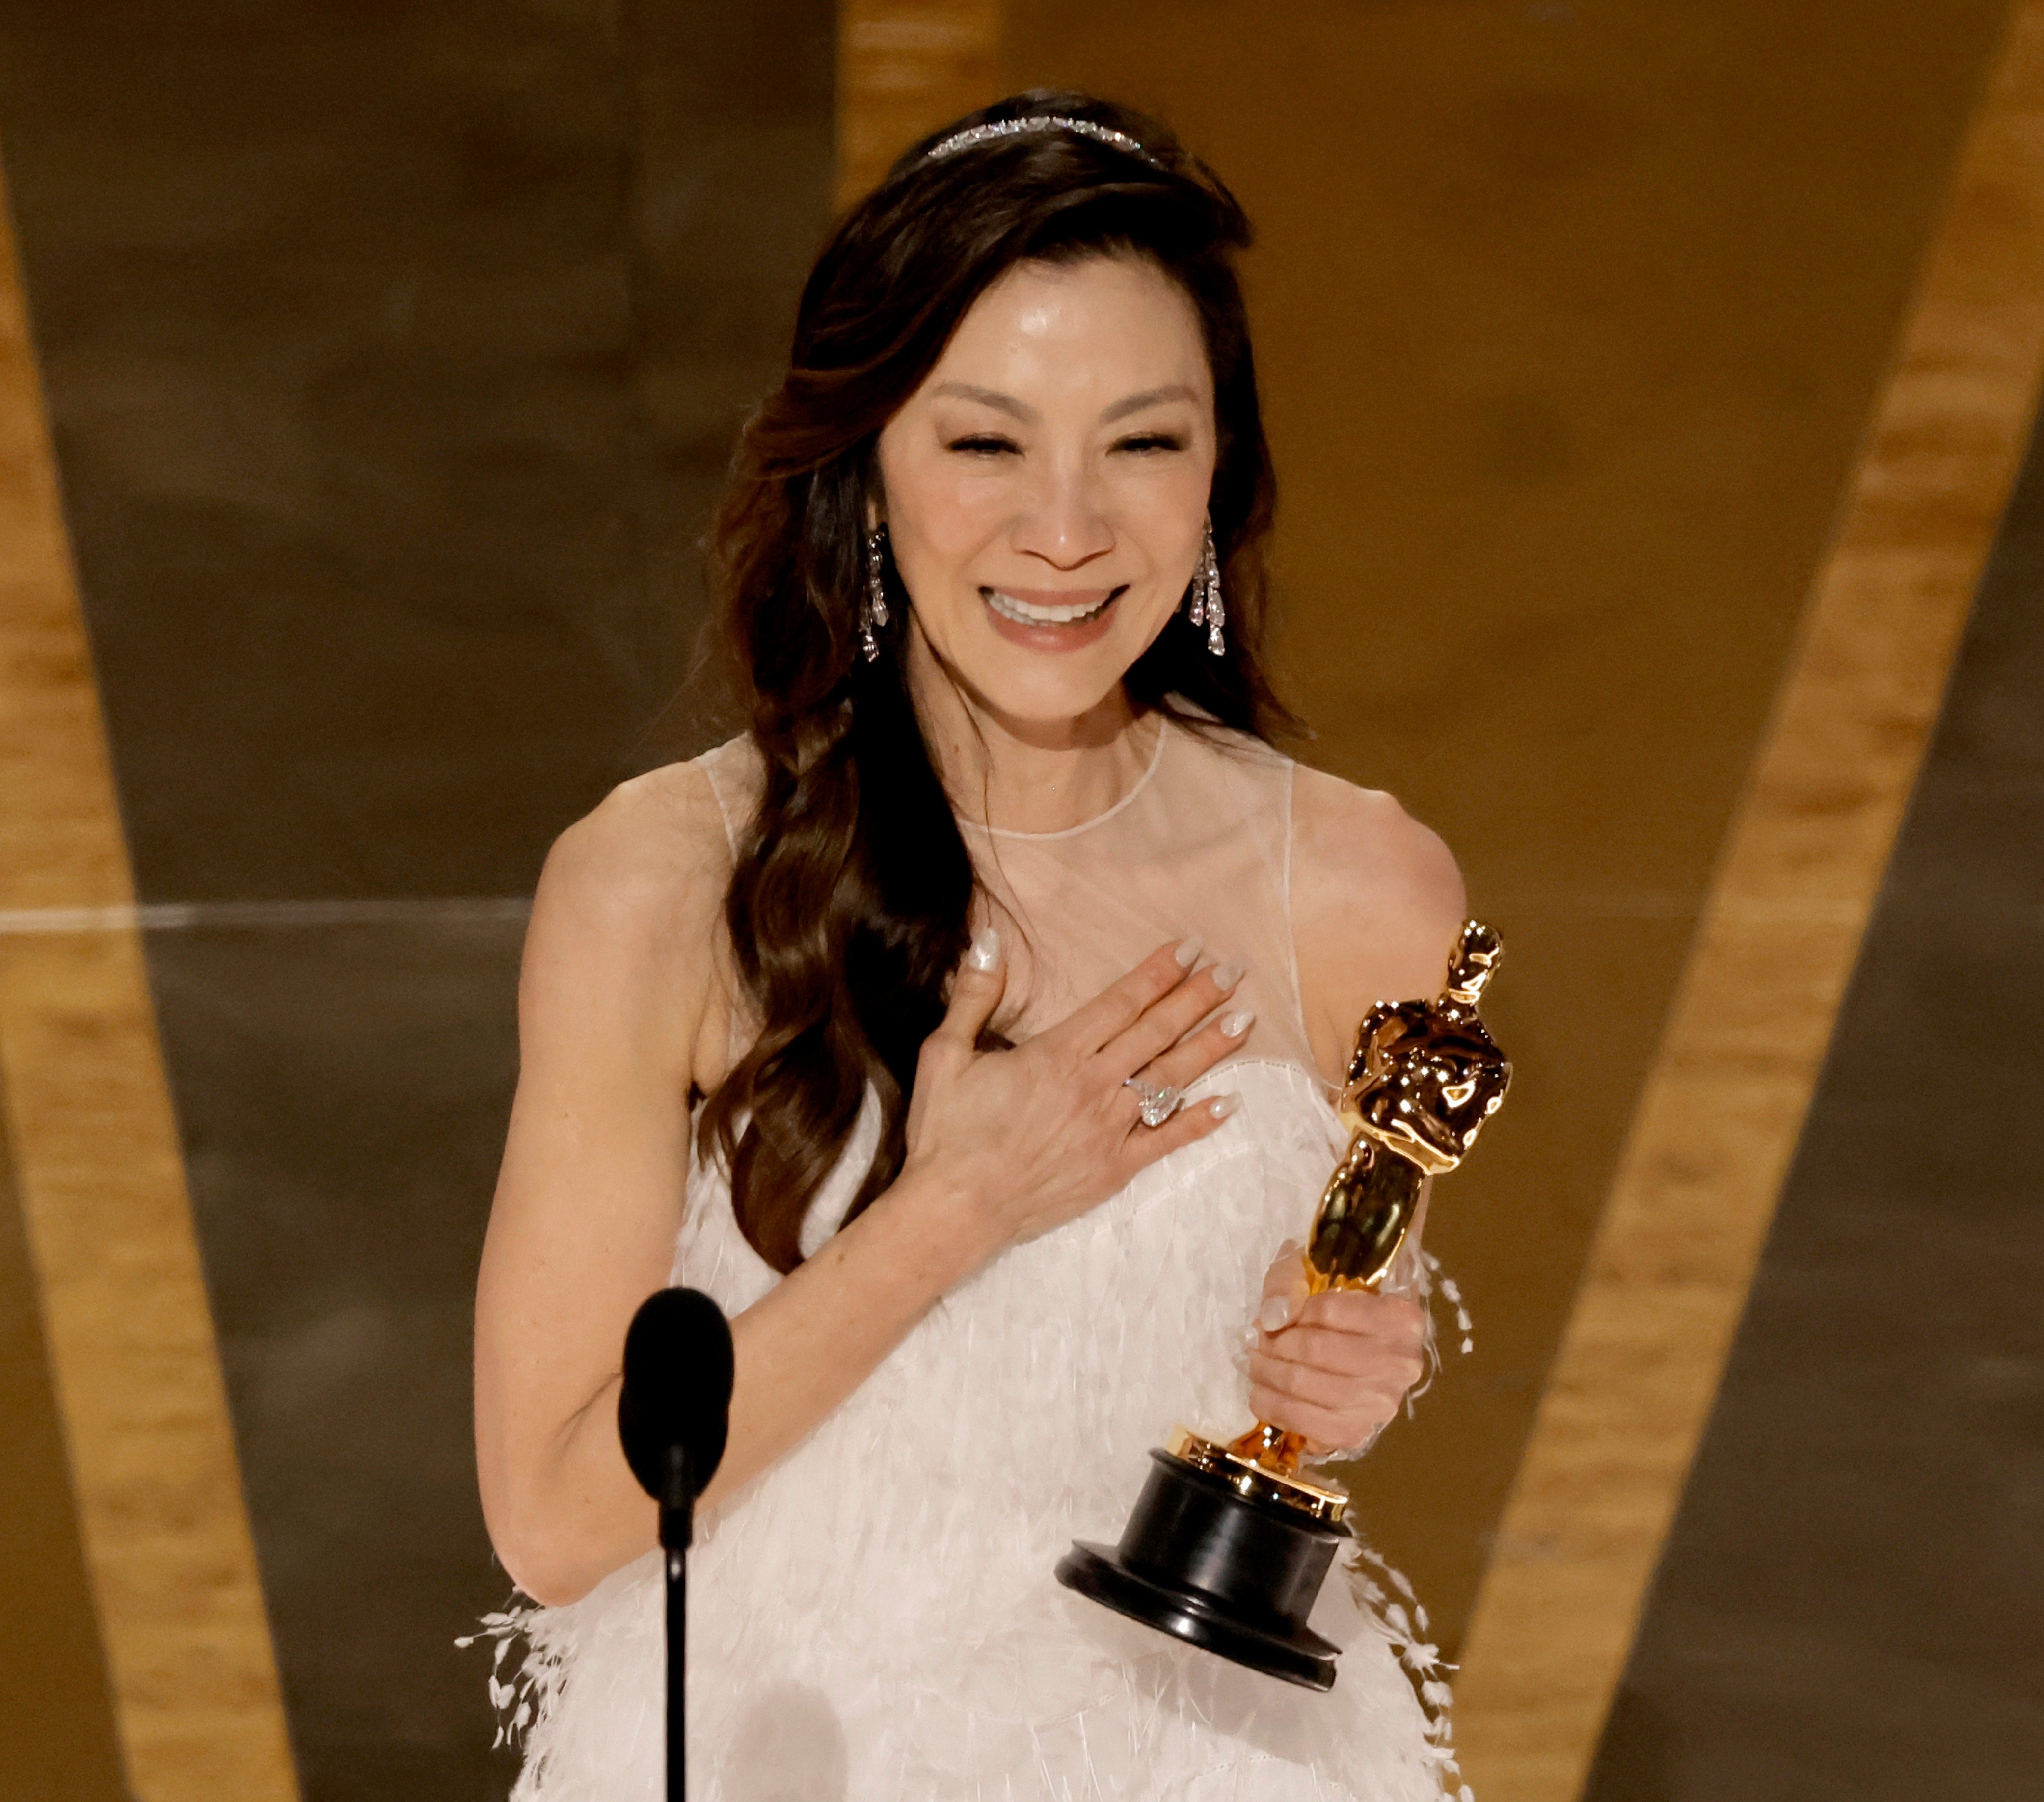
The Final Push and Victory (March 2023)
Final Strategy
Oscar Night
March 4, 2023: PGA win secured frontrunner status.
March 12, 2023: EEAAO won Best Picture and six other awards, including Best Director and acting awards.
March 5-7, 2023: Last Academy screenings targeted late voters; models predicted 90%-win probability.
A24 emphasized universal themes to broaden appeal.
Historic wins: Yeoh, first Asian Best Actress; A24 swept top categories.
Closing Stat: EEAAO's $14M budget yielded $140M gross—a 10x return.

Slide 11



Key Takeaways
Prescriptive Analytics
Operations Research
Impact
EEAAO's success hinged on key guild awards. Data became a winning playbook, demonstrating that a SAG Ensemble nomination boosted win odds by 10-15%.
Limited budgets ($14M) can be maximized to beat big spenders (10x return). OR allowed for optimal allocation, reallocating $1M to Academy events and $500K to final ads.
Analytics can revolutionize traditional fields like Oscar campaigns. The success of EEAAO demonstrates the potential to revolutionize traditional fields.

Slide 12

Thank You!!
I hope you enjoyed learning about the power of data!
May your next campaign be an Oscar winner!

